Slide 1
______ ______ __ __ ______ __ __ ______ ______ /\ ___\/\ __ \/\ "-./ \/\ == \/\ \/\ \ /\ ___\/\ == \ \ \ \___\ \ \/\ \ \ \-./\ \ \ _-/\ \ \ \ \___\ \ __\\ \ __< \ \_____\ \_____\ \_\ \ \_\ \_\ \ \_\ \_____\ \_____\ \_\ \_\ \/_____/\/_____/\/_/ \/_/\/_/ \/_/\/_____/\/_____/\/_/ /_/ _____ ______ ______ __ __ ______ ______ ______ /\ __-./\ ___\/\ ___\/\ \/\ \ /\ ___\/\ == \/\ ___\ \ \ \/\ \ \ __\\ \ __\\ \ \ \ \___\ \ __\\ \ __<\ \___ \ \ \____-\ \_____\ \_\ \ \_\ \_____\ \_____\ \_\ \_\/\_____\ \/____/ \/_____/\/_/ \/_/\/_____/\/_____/\/_/ /_/\/_____/
Justice Adams, Harsha Varma, & josh hilliard

Slide 2

Continuous Integration with TravisCI

Slide 3
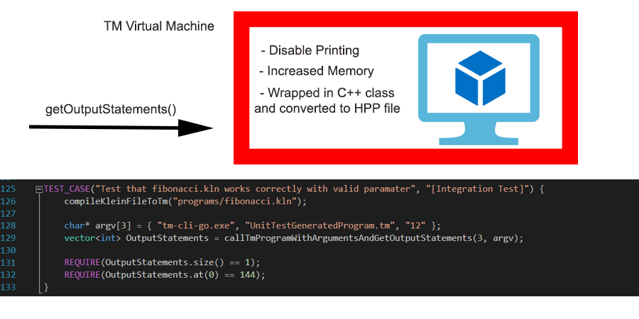
Hacking tm-cli-go

Slide 4
Program Structure
Vector of the ASTNodes
Problems with C++ (going in/out of scope with Vectors)
Vector Reserve
Instruction Manager
Ease of creating TM code
Helped bypass need for Three Address Code
Use of Maps/Enumerations
Helping unify code / security considerations
Unique use of maps to make life easier while coding

Slide 5

Running code
For the final submission, we implanted Cramer’s Rule for matrix multiplication
As a reminder to those who haven’t taken Linear Algebra or Algorithms recently:
Cramer’s Rule:
You can find the values of the variables by first getting determinate of a matrix
Ex: Find the values of x₁, x₂, & x₃ using
$\left[\begin{matrix}1 & 1 & −1 \\ 4 & −1 & 1 \\ 2 & −1 & −1\end{matrix}\right]$ * $\left[\begin{matrix}x_{1} \\ x_{2} \\ x_{3}\end{matrix}\right]$ = $\left[\begin{matrix}4 \\ 1 \\ 1\end{matrix}\right]$
$x_{1}=\frac{|A^{1}|}{|A|}$, $x_{2}=\frac{|A^{2}|}{|A|}$, $x_{3}=\frac{|A^{3}|}{|A|}$
See code in action

Slide 6
Questions?
No – go away. We’re done.

